Slide 1

The Maharaja Sayajirao University of Baroda
Faculty of Science
Department of Statistics
Data Science Data Analysis
Presented by: Aiman, Parth, Manali,
Pradeep, Grishma, Niyati

Slide 2

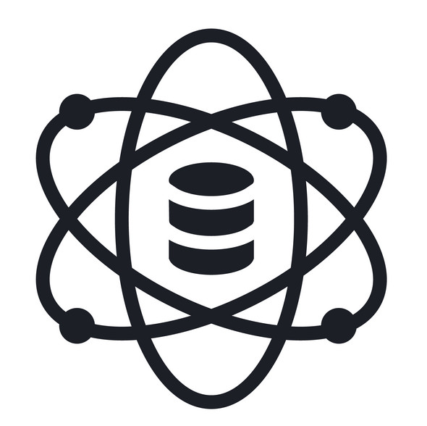


Data Science Data Analysis
2.5 Exabytes/day
New Sectors
New Fields

Slide 3
Data Science
Programming
Skills
Statistics
& Maths
Data
Science
Domain
Knowledge
The ART of uncovering the insights and trends in data

Slide 4
Data Science
Machine Learning Algorithms
Numbers
Text
Images
Video
Audio
to produce Artificial Intelligence (AI) systems to perform tasks that ordinarily require human intelligence.

Slide 5
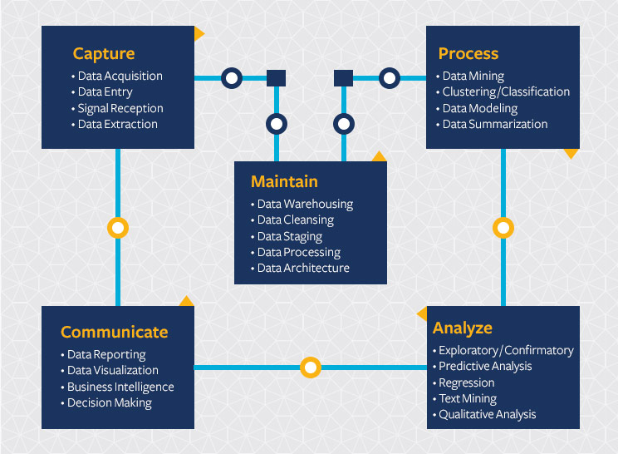
Data Science Cycle

Slide 6
Data Analysis
Science of examining a set of data to draw conclusions about the information to be able to make decisions or simply to expand the knowledge on various subjects.
Process of inspecting, cleansing, transforming, and modelling data with the goal of discovering useful information, giving conclusions, and supporting decision-making

Slide 7
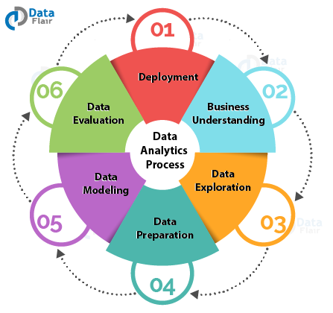
Data Analysis

Slide 8
Skills
Data Science Data modeling/visualization Programming languages Object-oriented programming Data warehouse/data mining Machine learning Computer science Statistics | Data Analytics Data mining Data warehousing/analytics Data visualization tools Predictive modeling Database reporting and management SQL/SAS/R programming

Slide 9
Job Roles
Data Science EDA (Exploratory Data Analytics) Machine learning processing and operations Data trend analysis and predictions Processing, verifying, and cleaning data integrity | Data Analytics Clean data EDA Create visual dashboards Develop KPIs

Slide 10
Q&A
One of the key variations between both is how each professional type finds out its solutions
Data Science They study the data to spot necessary questions to solve. Then, they focus on finding the solution. | Data Analytics These professionals get the questions directly and use their skills to prepare answers.

Slide 11
Data processing
Data processing may involve various processes, including:
Validation
Sorting
Summarization
Aggregation
Analysis
Reporting
Classification

Slide 12
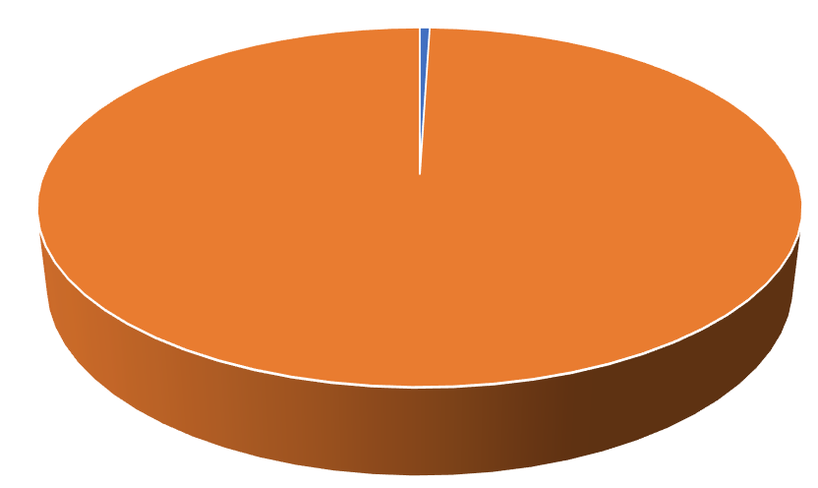
Astonishing Facts About Data Science Analytics
Less than 0.5% of all data we create is ever analysed and used.
By 2025, Data Science sector in India is estimated to grow by $16 Billion (1,600 crore).
A 10% increase in data accessibility will result in more than $65 million additional net income for the typical Fortune 1000 company.
Google uses about 1,000 computers to answer every single search query.
Every second 60,000 search queries are performed on Google
By 2020, about 1.7 megabytes of new information will be created every second for every human on the planet.
1 billion pieces of content are shared via Facebook’s Open Graph every day.

Slide 13
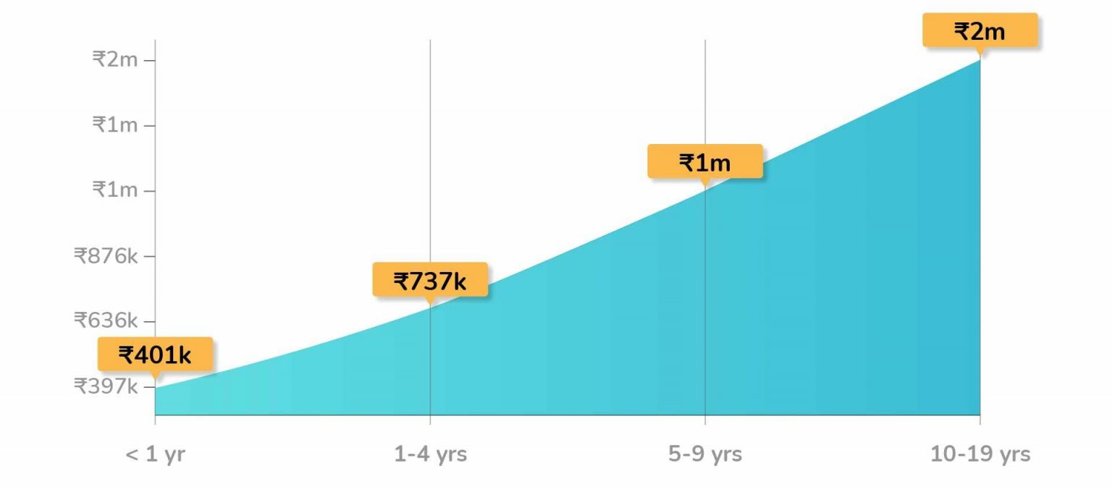
Experience Vs Salary of Data Scientists in INDIA-2021

Slide 14
Data Scientist’s Income in India Based on Location

Slide 15
Data Scientist’s Income in India Based on Employer

Slide 16
Future Scopes
Industry
Health care sector
Transport Sector
E-commerce
Wrangling of data
Cloud computing
Academic
Improve Adaptive Learning
Better Parent Involvement
Better Assessment of Teachers
Improve Student’s Performance
Regular Updates in the Curriculum

Slide 17
Careers
Data Architect
Applications Architect
Infrastructure Architect
Enterprise Architect
Statistician
Data Analyst
Data Scientist
Data Engineer
Machine Learning Scientist

Slide 18

Gaurav Sir and Classmates……..

